Slide 1
CS174A Lecture 3

Slide 2
Announcements & Reminders
Download latest syllabus from canvas
1/21/24: A1 due by Sunday midnight
2/04/24: A2 due; will be discussed during this week’s TA session
2/08/24: Midterm Exam: 6:00-7:30 PM PST, in person, in class
Start forming your project teams (team size: 2-4)
2/28/24: initial project proposals & teams due
3/13/24: final proposals due

Slide 3
Last Lecture Recap
A Basic Graphics System
Input devices: keyboard, mouse, tablet, touchscreens
CPU/GPU
Frame Buffer: resolution, single vs. double buffering, color depth, interlaced vs. non-interlaced, refresh rate
Output devices: CRT (random-scan & raster), flat-panel (LED, LCD, Plasma), printers, plotters, head-mounted devices, stereo displays
Linear Algebra
Vectors: magnitude, unit vector, normalizing, addition, multiplication, properties
Linear combination of vectors: affine, convex, linear independence (today)

Slide 4
Next Up
Coordinate systems
Vectors: basis vectors, dot product, cross product
Matrices: square, zero, identity, symmetric, matrix operations
Homogeneous representations of points and vectors
Representing shapes: lines, circles
Transformations: translation, scaling, rotation, shear

Slide 5
Summary of Scalar, Point & Vector Ops
Red font = makes sense for affine, does not make sense for linear operations
Operands | Operands | Add (+) | Subtract (-) | Multiply (*)
_{Scalar-Scalar} | s₁, s₂ | s = s₁ + s₂ | s = s₁ – s₂ | s = s₁ * s₂
_{Point-Point} | P₁, P₂ | P = a₁*P₁ + a₂*P₂ | v = P₂ – P₁ | X
_{Vector-Vector} | v₁, v₂ | v = v₁ + v₂ | v = v₁ – v₂ | X
_{Scalar-Point} | s, P₁ | X | X | P = s * P₁
_{Scalar-Vector} | s, v₁ | X | X | v = s * v₁
_{Point-Vector} | P₁, v₁ | P₂ = P₁ + v₁ | P₂ = P₁ – v₁ | X

Slide 6
Affine & Convex Combinations
Parametric form of lines
Line: infinite in both directions
Ray: infinite in one direction
Edge (or line segment): limited in both directions
Affine combination of points
Convex combination of points
Parametric form of planes
Affine combination of points
Convex combination of points

Slide 7
Generators and Base Vectors
How many vectors are needed to generate a vector space?
Any set of vectors that generate a vector space is called a generator set
Given a vector space R^{n} we can prove that we need minimum n vectors to generate all vectors v in R^{n}
A generator set with minimum size is called a basis for the given vector space

Slide 8
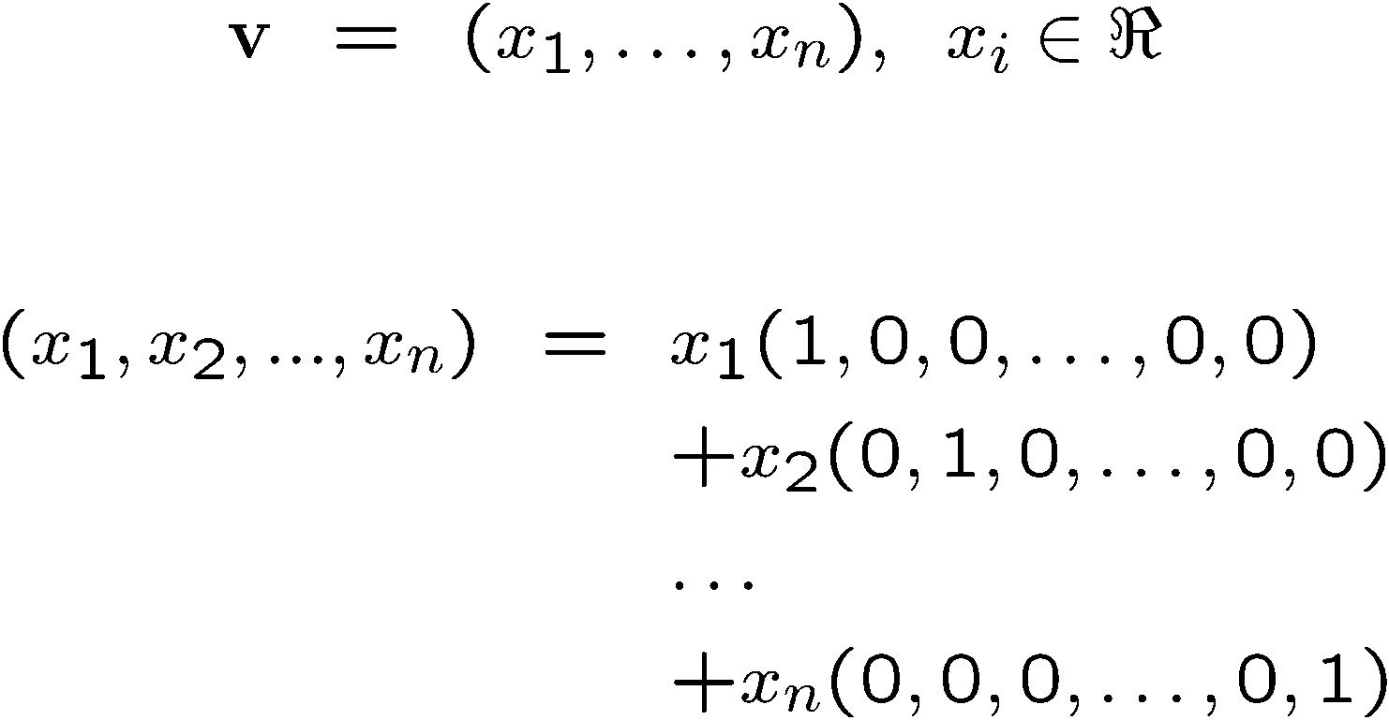
Standard Unit Vectors
Notes:
\documentclass{slides}\pagestyle{empty}
\begin{document}
\begin{eqnarray*}
{\bf v} & = & (x_1,x_2,\dots,x_n),\;\; x_i \in \Re \\
\end{eqnarray*}
\begin{eqnarray*}
(x_1,...,x_n) & = & x_1(1,0,0,\dots,0,0) \\
& & +x_2(0,1,0,\dots,0,0)\\
& & \dots \\
& & +x_n(0,0,0,\dots,0,1)\\
\end{eqnarray*}
\end{document}

Slide 9
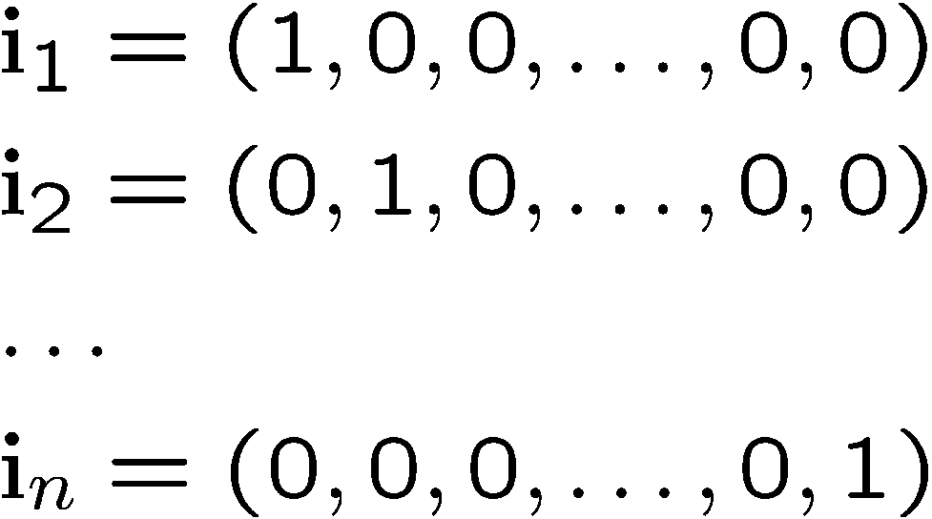
Standard Unit Vectors
For any vector space R^{n}:
The elements of a vector v in R^{n} are the scalar coefficients of the linear combination of the basis vectors
Notes:
\documentclass{slides}\pagestyle{empty}
\begin{document}
\begin{eqnarray*}
& & {\bf i}_1 = (1,0,0,\dots,0,0) \\
& & {\bf i}_2= (0,1,0,\dots,0,0)\\
& & \dots \\
& & {\bf i}_n= (0,0,0,\dots,0,1)\\
\end{eqnarray*}
\end{document}

Slide 10
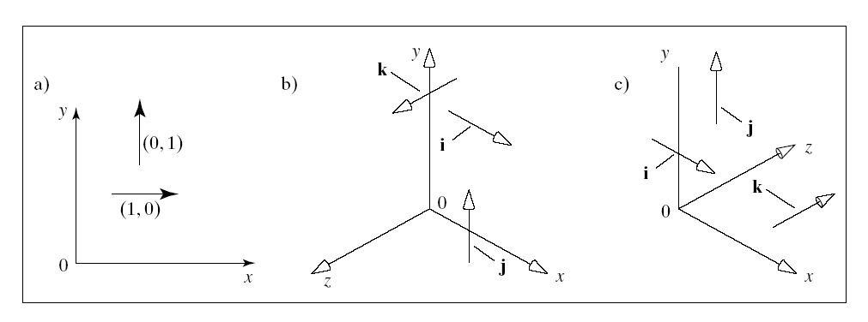
Standard Unit Vectors in 2D & 3D
i = (1,0)
j = (0,1)
i = (1,0,0)
j = (0,1,0)
k = (0,0,1)
Right handed
Left handed

Slide 11
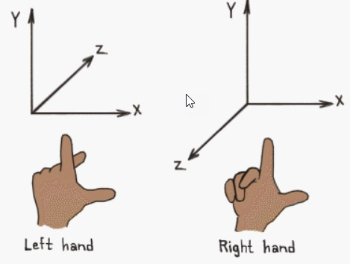
Right & Left Hand Coordinate Systems

Slide 12
Representation of Vectors Through Basis Vectors
Given a vector space R^{n},
a set of basis vectors B {b_{i} in R^{n}, i=1,…n} and
a vector v in R^{n}
we can always find scalar coefficients such that:
v = a₁b₁+…+a_{n}b_{n}
So, vector v expressed with respect to B is:
v_{B} = (a₁,…,a_{n})
Notes:
By definition of what a basis is.

Slide 13
Dot Products in Graphics
Another problem dot products solve: Comparing Vectors
Trig measurements!

Slide 14
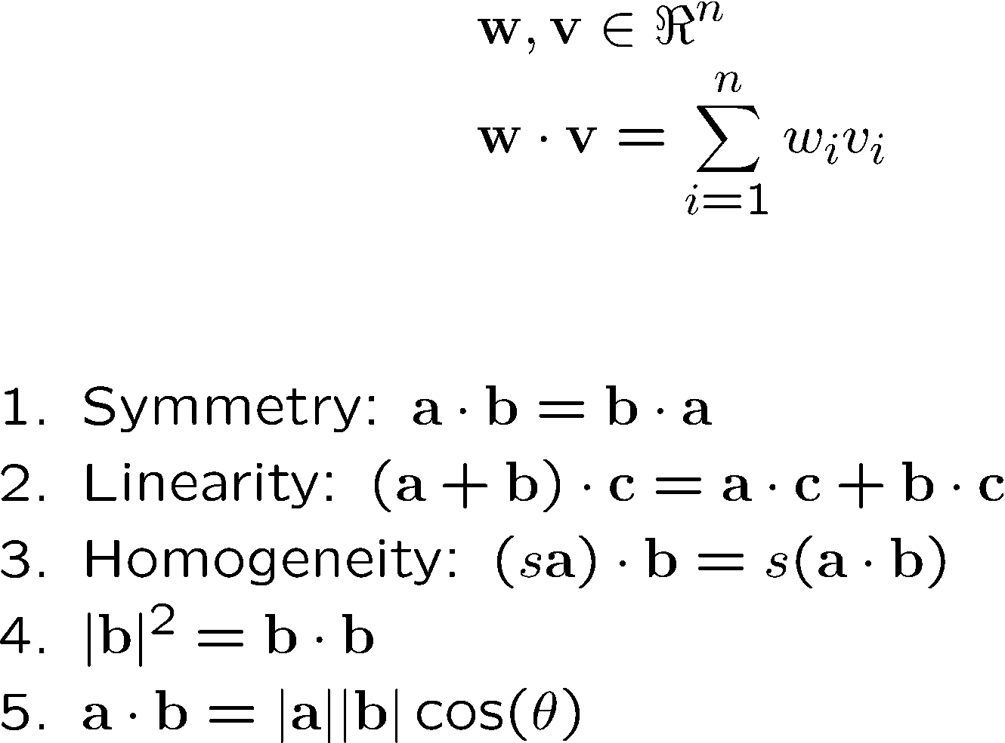
Dot (Scalar) Product
Definition:
Properties
Notes:
\documentclass{slides}\pagestyle{empty}
\begin{document}
\begin{eqnarray*}
& & {\bf w},{\bf v} \in \Re^n \\
& & {\bf w \cdot v} = \sum^n_{i=1} w_iv_i
~\\
~\\
\end{eqnarray*}
Summetry: ${\bf a \cdot b} = {\bf b \cdot a}$ \\
Linearity: ${(\bf a + b) \cdot c} = {\bf a \cdot c} + {\bf b \cdot c}$\\
Homogeneity: $(s{\bf a) \cdot b} = s ({\bf a \cdot b})$ \\
$|{\bf b}|^2 = {\bf b \cdot b}$
\end{document}

Slide 15
Dot Product and Perpendicularity
From Property 5:
a · b > 0
a · b = 0
a · b < 0

Slide 16
Perpendicular Vectors
Definition
Vectors a and b are perpendicular iff a·b=0
Also called “normal” or “orthogonal” vectors
It is easy to see that the standard unit vectors form an orthogonal basis:
i∙j=0, j∙k=0, i∙k=0

Slide 17
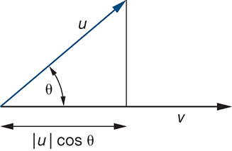
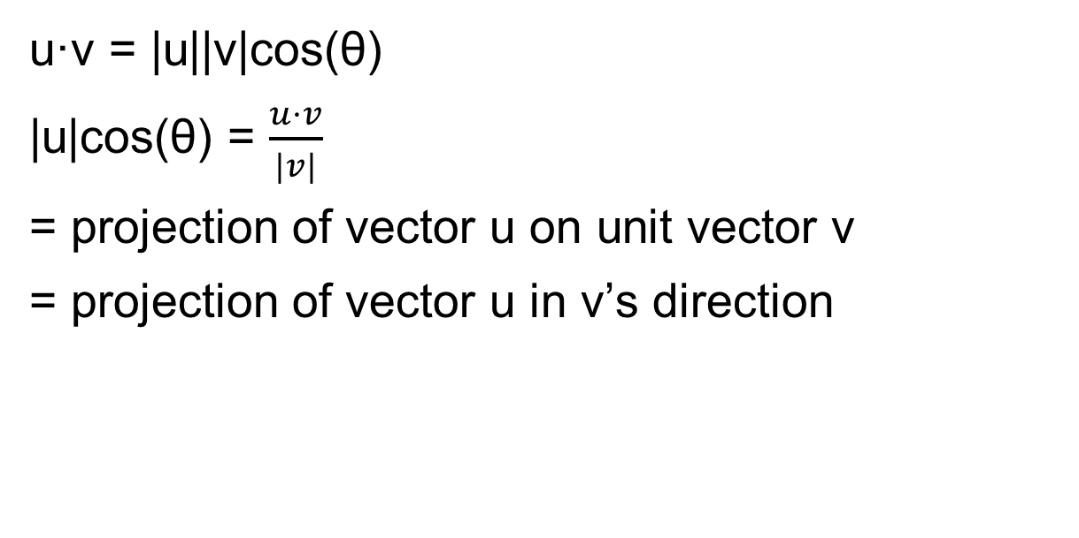
Dot Product: Projection
u·v = |u||v|cos(θ)
|u|cos(θ) = $\frac{u·v}{|v|}$
= projection of vector u on unit vector v
= projection of vector u in v’s direction

Slide 18
Dot Products in Graphics
The problem dot products solve in graphics:
Dot with a vector of coefficients. Now you have a linear function that maps a point onto a scalar
3x + 4y + 5z = ?
Predictable effect as you adjust a coordinate

Slide 19
Dot Products and Matrices
What if we want a function that produces not a scalar, but a new point?
This would become a tool for moving points somewhere new!
How do we generate three scalar outputs instead of one?

Slide 20
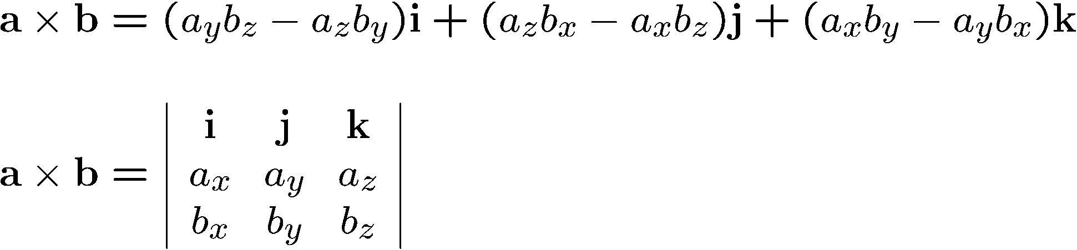
Cross (Vector) Product
Defined only for 3D vectors and with respect to the standard unit vectors
Definition
Notes:
\documentclass{slides}\pagestyle{empty}
\begin{document}
\begin{eqnarray*}
& & {\bf a} \times {\bf b} = (a_yb_z - a_zb_y) {\bf i} +
(a_zb_x - a_xb_z) {\bf j} +
(a_xb_y - a_yb_x) {\bf k} \\
~\\
& & {\bf a} \times {\bf b} =
\left|
\begin{array}{ccc}
{\bf i} & {\bf j} & {\bf k} \\
a_x & a_y & a_z \\
b_x & b_y & b_z \\
\end{array} \right|
\end{eqnarray*}
\end{document}

Slide 21
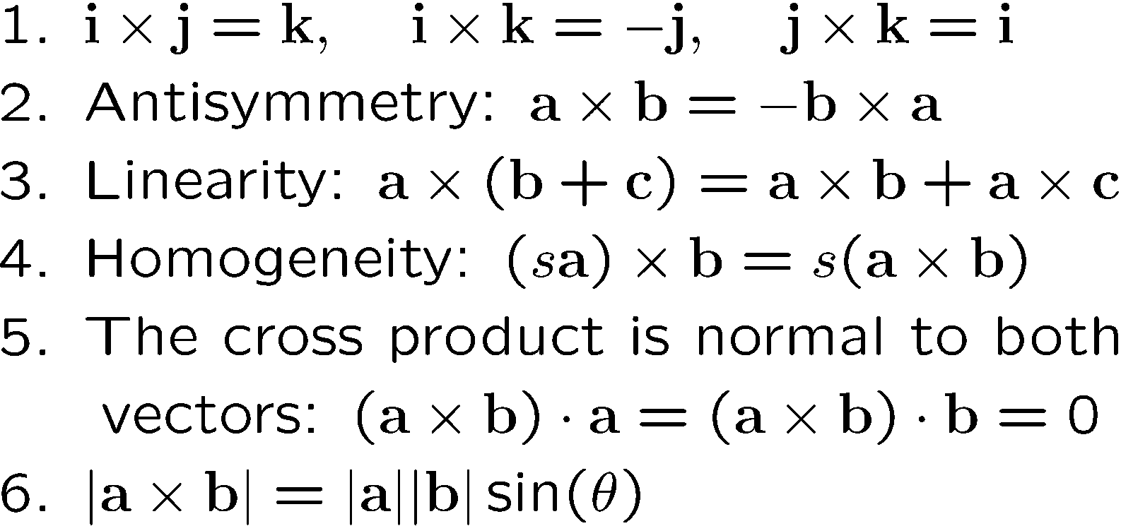
Properties of the Cross Product
Notes:
\documentclass{slides}\pagestyle{empty}
\begin{document}
1. ${\bf i} \times {\bf j} = {\bf k}, {\bf i} \times {\bf j}
= {\bf k}, {\bf i} \times {\bf j} = {\bf k}.$ \\
2. Antisymmetry: $ {\bf a} \times {\bf b} = -{\bf b} \times {\bf a}$.\\
3. Linearity: $ {\bf a} \times ({\bf b} + {\bf c}) =
{\bf a} \times {\bf b} + {\bf a} \times {\bf c}$.\\
4. Homogeneity: $(s{\bf a}) \times {\bf b} = s({\bf a} \times {\bf b})$.\\
5. The cross product is normal to both vectors:
$({\bf a} \times {\bf b}) \cdot {\bf a} = 0$ and
$({\bf a} \times {\bf b}) \cdot {\bf b} = 0$. \\
6. ${\bf a} \times {\bf b} = |{\bf a}||{\bf b}|sin(\theta)$.
\end{document}

Slide 22
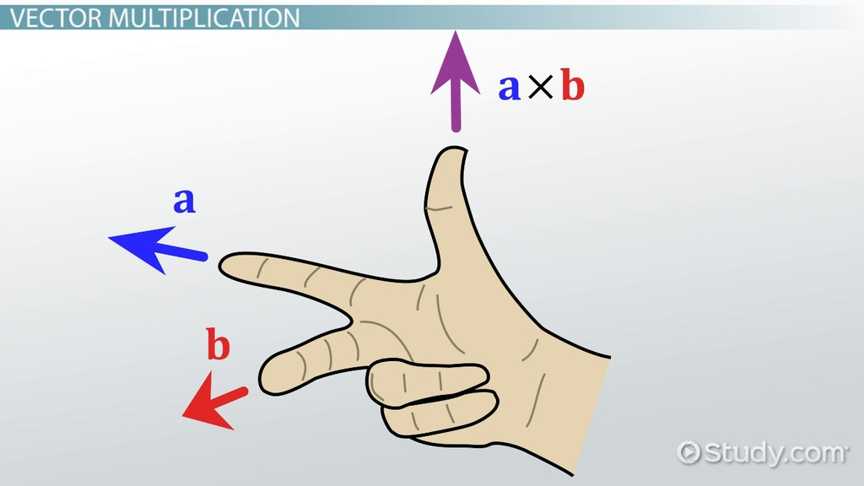
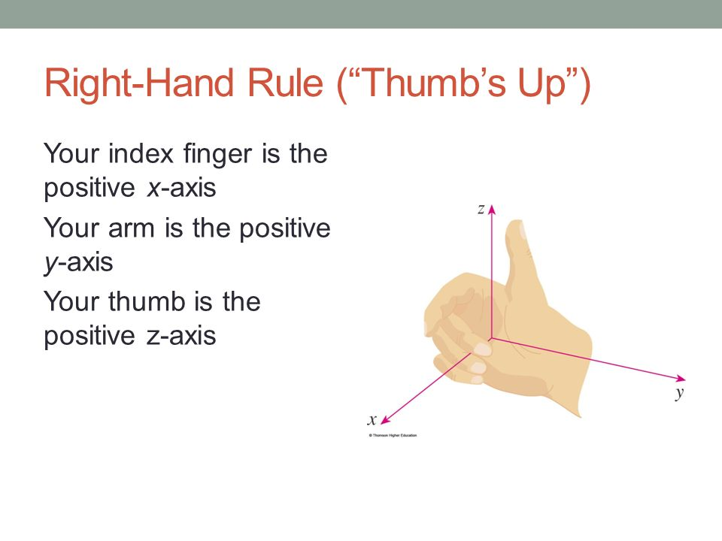
Direction of Cross Product
Notes:
\documentclass{slides}\pagestyle{empty}
\begin{document}
1. ${\bf i} \times {\bf j} = {\bf k}, {\bf i} \times {\bf j}
= {\bf k}, {\bf i} \times {\bf j} = {\bf k}.$ \\
2. Antisymmetry: $ {\bf a} \times {\bf b} = -{\bf b} \times {\bf a}$.\\
3. Linearity: $ {\bf a} \times ({\bf b} + {\bf c}) =
{\bf a} \times {\bf b} + {\bf a} \times {\bf c}$.\\
4. Homogeneity: $(s{\bf a}) \times {\bf b} = s({\bf a} \times {\bf b})$.\\
5. The cross product is normal to both vectors:
$({\bf a} \times {\bf b}) \cdot {\bf a} = 0$ and
$({\bf a} \times {\bf b}) \cdot {\bf b} = 0$. \\
6. ${\bf a} \times {\bf b} = |{\bf a}||{\bf b}|sin(\theta)$.
\end{document}

Slide 23
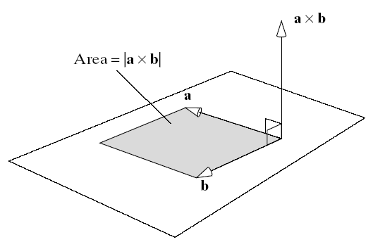
Geometric Interpretation of the Cross Product

Slide 24
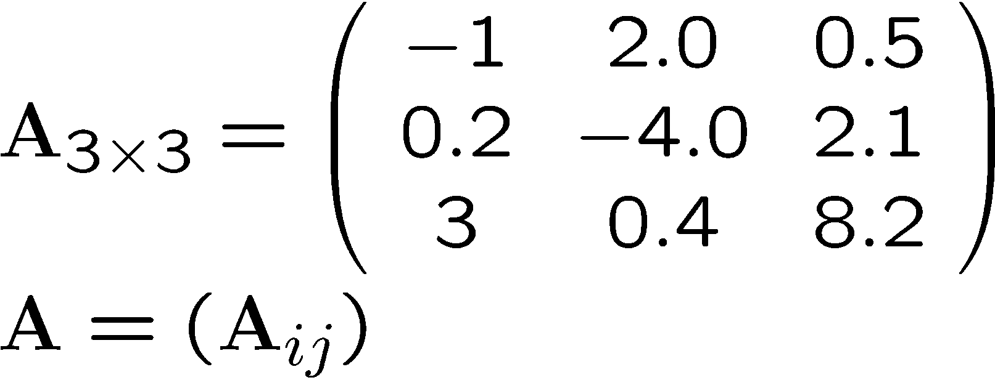
Matrices
Rectangular arrangement of scalar elements
Matrix:
Bold upper-case
Notes:
\documentclass{slides}\pagestyle{empty}
\begin{document}
\[ A_{3 \times 3} = \left ( \begin{array}{ccc}
-1 & 2.0 & 0.5 \\
0.2 & -4.0 & 2.1 \\
3 & 0.4 & 8.2 \\
\end{array} \right)
\]
\end{document}

Slide 25
Special Square (n x n) Matrices
Zero matrix: A_{ij} = 0 for all i,j
I_{ii} = 1 for all i
Identity matrix: I_{n} =
I_{ij} = 0 for i ≠ j
Symmetric matrix: (A_{ij} ) = (A_{ji} )

Slide 26
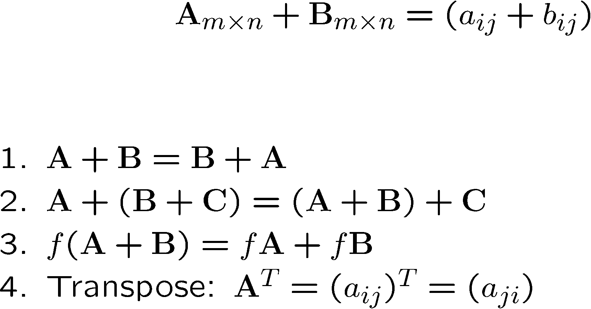
Operations with Matrices
Addition:
Properties:
Notes:
\documentclass{slides}\pagestyle{empty}
\begin{document}
\begin{eqnarray*}
& & A_{m \times n} + B_{m \times n} = (a_{ij} + b_{ij})
\end{eqnarray*}
~\\
~\\
1. $A+B = B + A$.\\
2. $A + (B+C) = (A+B) + C$.\\
3. $f(A+B) = fA+fB$.\\
4. Transpose: $A^T = (a_{ij})^T=(a_{ji})$.
\end{document}

Slide 27
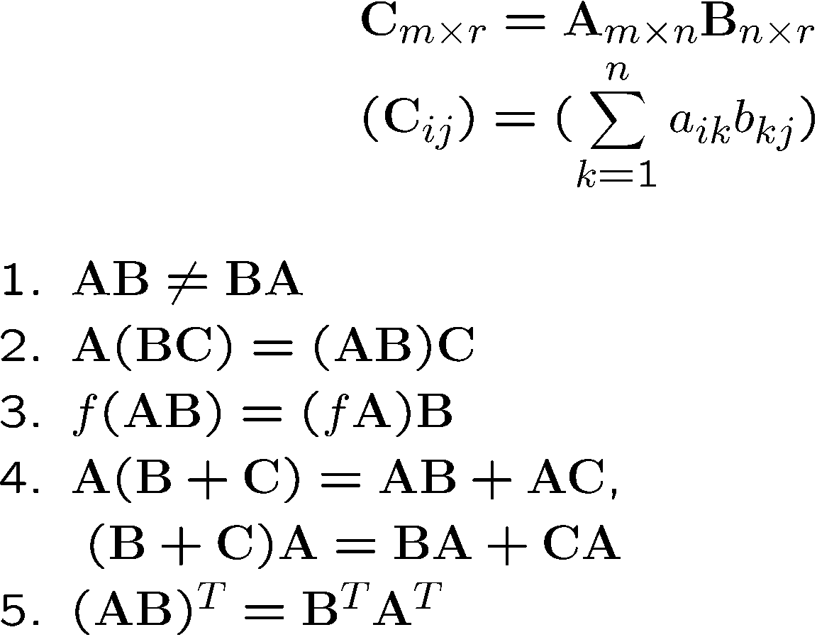
Multiplication
Definition:
Properties:
Notes:
\documentclass{slides}\pagestyle{empty}
\begin{document}
\begin{eqnarray*}
& & C_{m \times l} = A_{m \times n} B_{n \times r} \\
& & (C_{ij}) = (\sum_k^n a_{ik}b_{kj})\\
\end{eqnarray*}
1. $AB \neq BA$.\\
2. $A (BC) = (AB)C$.\\
3. $f(AB) = (fA)B$.\\
4. $A(B+C) = AB+AC$, \\
$(B+C)A = BA+CA$.\\
5. $(AB)^T = B^TA^T$.
\end{document}

Slide 28
Inverse of a Square Matrix
Definition
MM⁻¹ = M⁻¹M = I
Important property
(AB)⁻¹= B⁻¹ A⁻¹

Slide 29
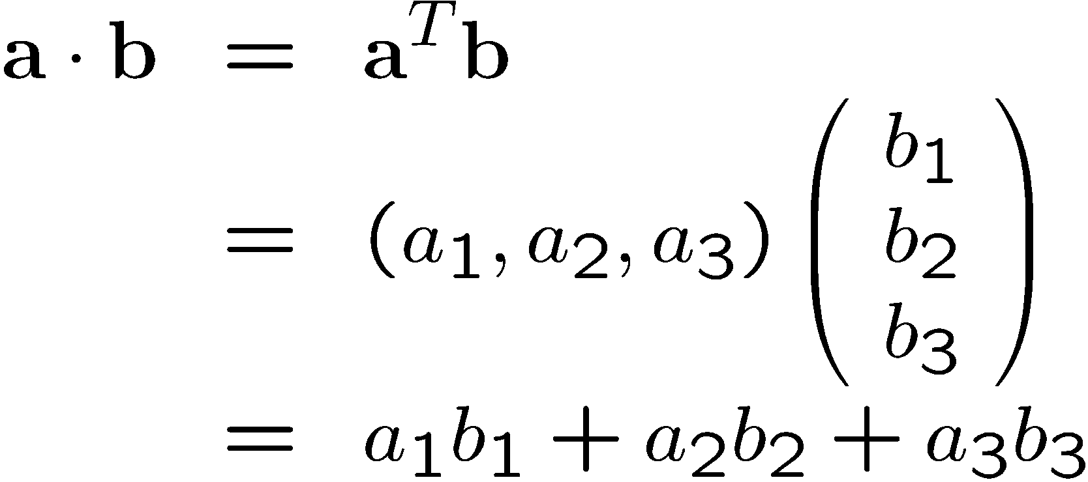
Dot Product as a Matrix Multiplication
Representing vectors as column matrices:

